Slide 1
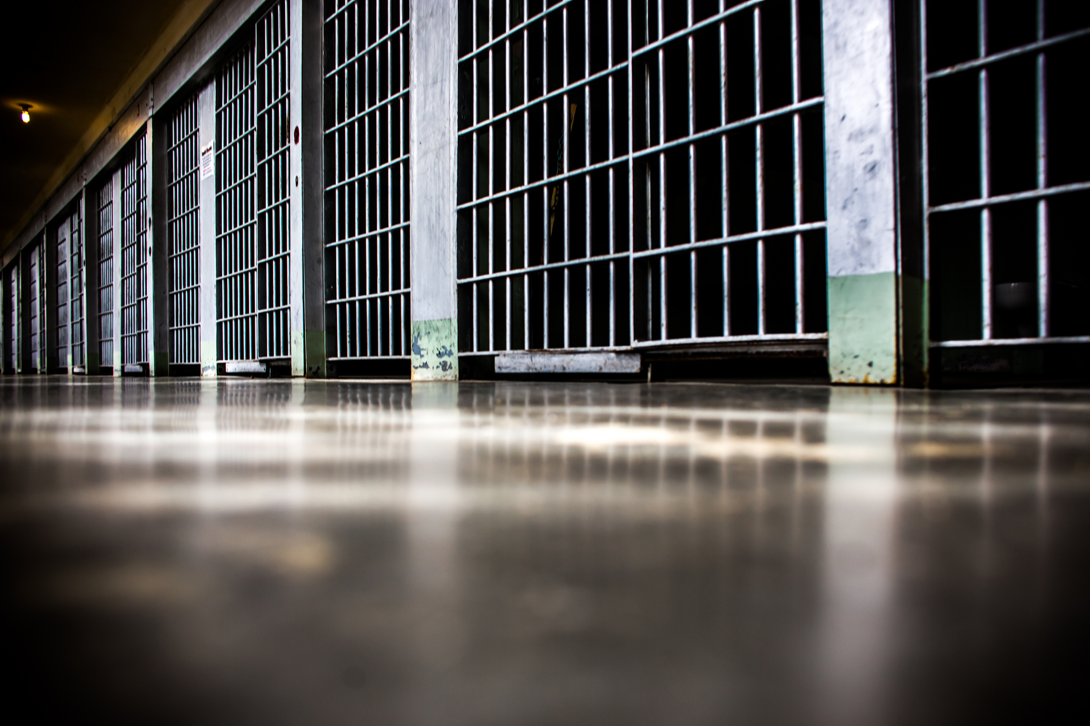

Jail Ministry
A Mission Field in Our Backyard

Slide 2
Mass Incarceration
JAILS
In Our Backyard
One in Three Incarcerated Persons
High Suicide Rates

Slide 3
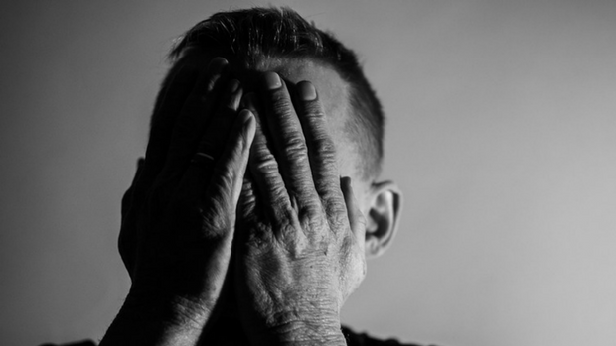
Incarcerated
people
experience
profound
Loss
Brokenness
Shame

Slide 4

Most Incarcerated People have experienced
Trauma
Addictions
Mental Illness
Notes:
People who have experienced trauma. Reports indicate that 77-98% of the incarcerated have experienced interpersonal violence and/or physical/sexual abuse.
People who have experienced addiction. Research reports that ??% of the incarcerated used drugs prior to their arrest.
People who have mental illness. % of incarcerated men and 73% of incarcerated women report having a mental illness.

Slide 5
Children with an Incarcerated Parent
More than 2.7 million children
1 in 28
About half under the age of 10
The Pew Charitable Trusts: Pew Center on the States. Collateral Costs: Incarceration’s Effect on Economic Mobility. Washington, DC. 2010
Mauer, M., Nellis, A., Schirmir, S.; Incarcerated Parents and Their Children-Trends 1991-2007, The Sentencing Project, Feb. 2009 – http://www.sentencingproject.org
Notes:
More than 2.7 million children in the U.S. have an incarcerated parent. That is 1 in 28 children.
Approximately half of these children are under the age of 10.

Slide 6
Feelings and Impact on Children
Fear and anxiety
Disruptive living conditions
Lack of contact with incarcerated parent
Shame and stigma

Slide 7
Cook County Jail
Population: 5900, capacity of 10,000
About 100,000 circulate through the jail annually
Incarceration rate 238.3 per 100,000

Slide 8
Cook County Jail residents
Males (86%)
Females (13%)
67% African-American
21% Hispanic
13% Caucasian
33 years old
85% single
68% African-American
20% Hispanic/Other
14% Caucasian
34 years old
86% single

Slide 9
Cook County Jail OFFENSE TYPES

Slide 10

The Church has the Answer

Slide 11
The Church can bring
hope and healing
by showing and sharing
the love of Christ.

Slide 12
Jesus said… Go and make disciples of all nations Matthew 28:19
Jesus said … Love your neighbor as yourself
Mark 12:31

Slide 13
Jesus said…
“For I was hungry, and you gave Me something to eat; I was thirsty, and you gave Me drink; I was a stranger, and you invited me in; naked and you clothed Me; I was sick, and you visited Me; I was in prison, and you came to Me. . . Truly I say to you, to the extent that you did it to one of these brothers of Mine, even the least of them, you did it to Me.”
Matthew 25:35,36,40

Slide 14
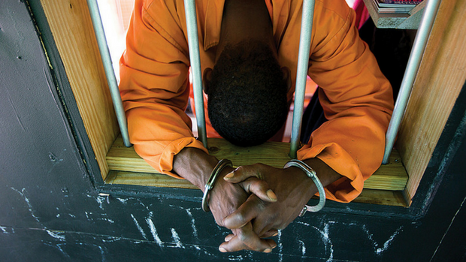
The Church can make a difference
in the lives
of those
society wants
to forget.

Slide 15
What is Jail Ministry?

Slide 16
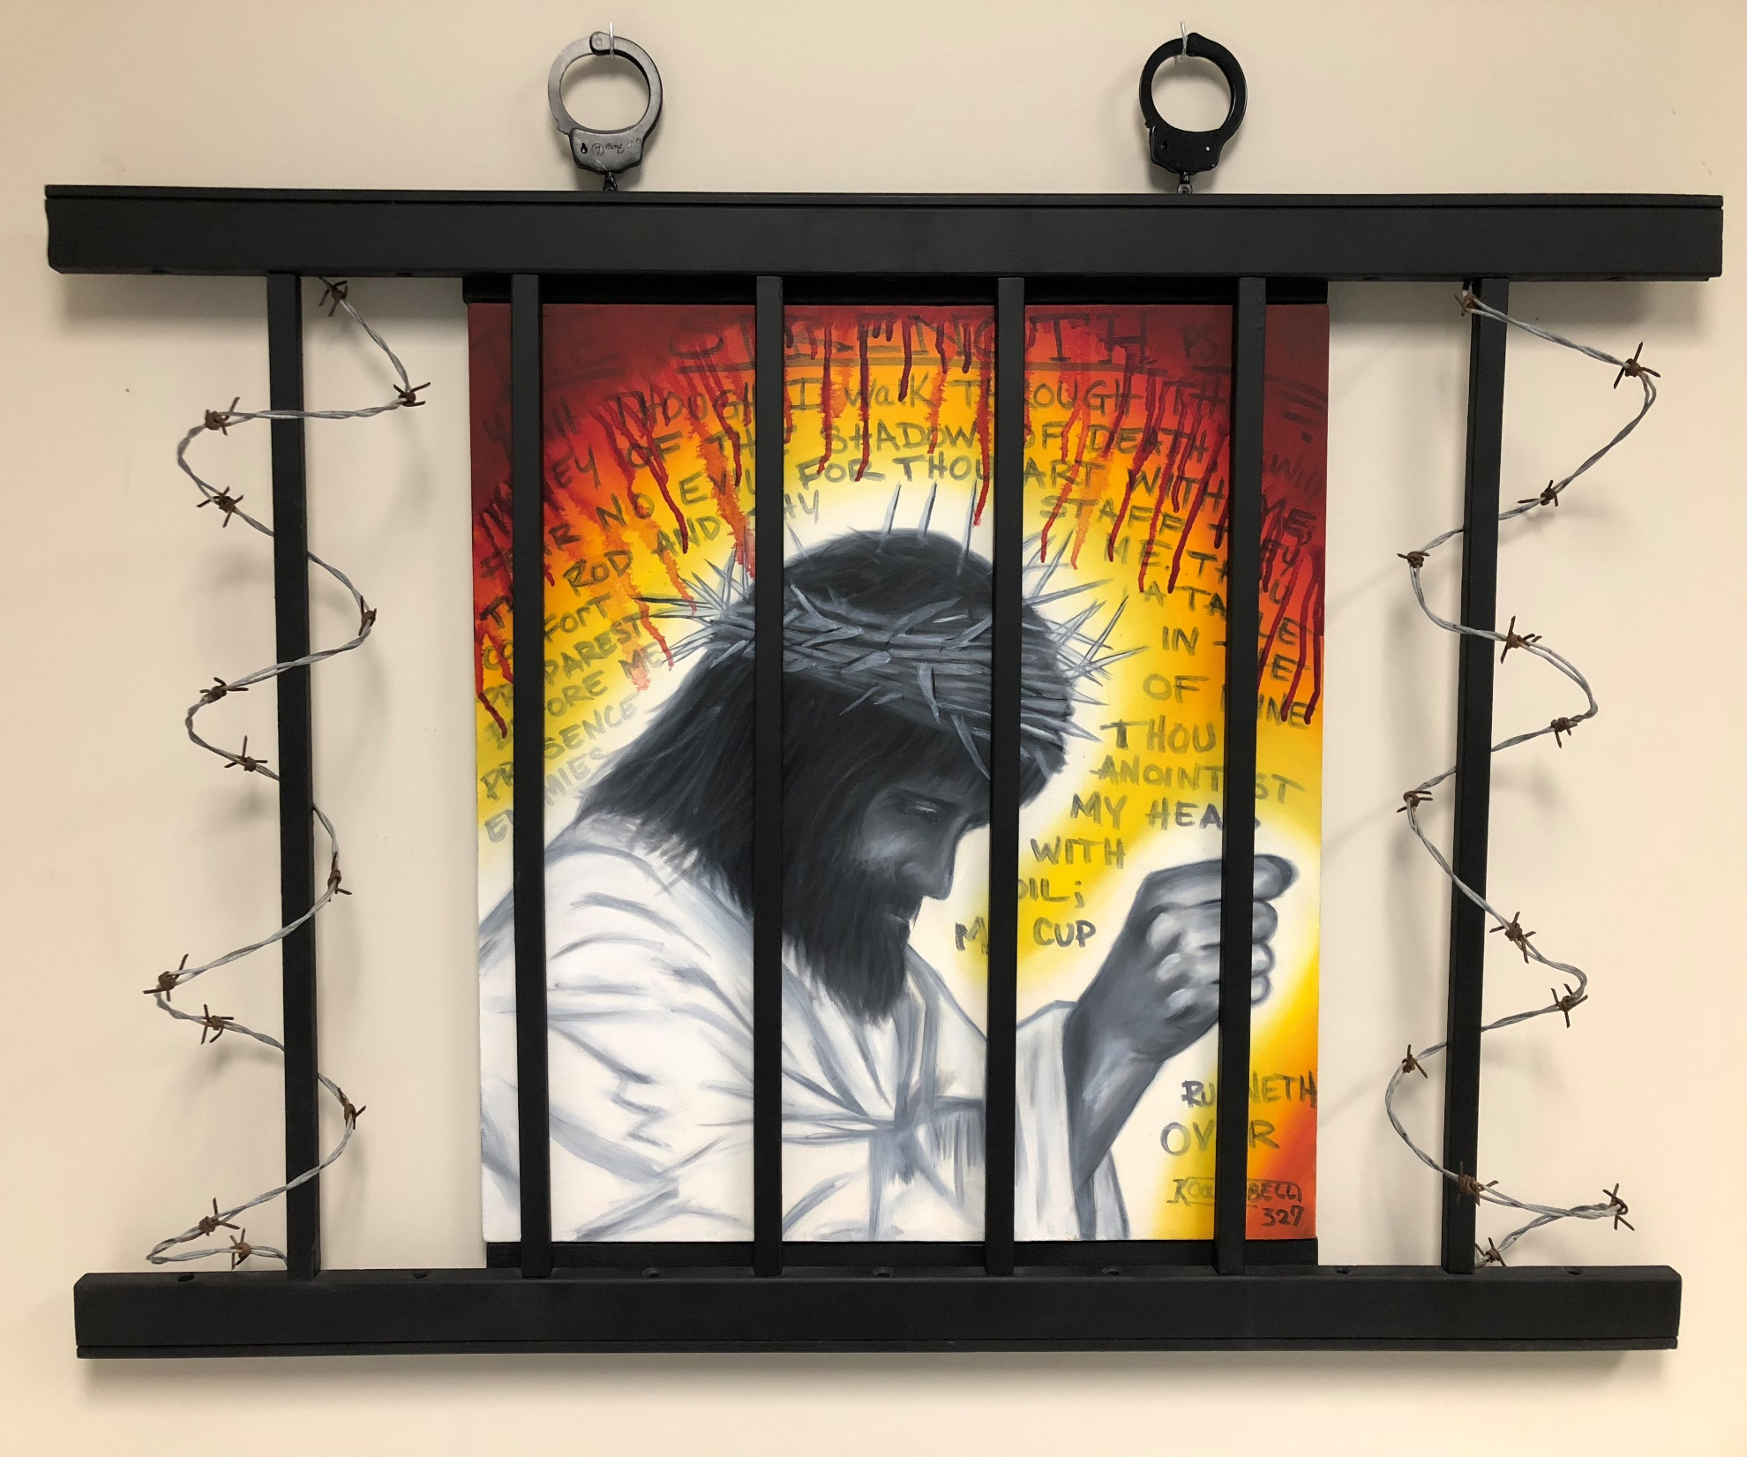
Jail Ministry is providing compassionate holistic care through the transforming message of
the gospel with those who are justice-involved

Slide 17
What is God calling you to do?

Slide 18
Next Steps
MINISTRY NEEDS
One-on-One
Bibles
PRAY
MINISTRY CONTACT
Kati Williams
kwill@gmail.com
MEETING
January 15 at 7 pm
Community Church

Slide 19

A Toolkit for Churches www.lausannena.org
A Guide for Starting a Jail Ministry
Communication Tools
Trainings
National Organizations
Resources

